Slide 1
CORNELL SEBA

Slide 2
AGENDA
Current Events – Brett
Resume Writing – Tim & Walter
Break into groups to review and construct resumes
Sign ups for VSE
Sign ups for Subcommittees

Slide 3
CURRENT EVENTS
Brett Provenzano

Slide 4
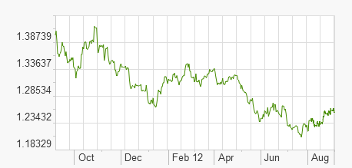
What’s new?
Dow Jones: 13035
US Debt: almost $16 trillion
US Unemployment: 8.3%
46 million Americans on food stamps
Barrel of oil: $95.40
1.25 Dollar: Euros

Slide 5
World Economic Woes
US World relations
  US-Iran crisis
    Strait of Hormuz: Effect on gasoline price
    Potential of preemptive strike from Israel
    Syria as a proxy of Iran
  US-China
    South China Sea: Maritime Boarder Dispute
    Copyright infringement
    Currency manipulation
Troubled Economies: Japan, Italy, Greece, Spain
Notes:
Japan: Deflation

Slide 6
Happening Now
RNC and DNC Conventions
Mark Zuckerburg keeping his stock
  Current Facebook Stock Price:
    $17.73 from high of $45.00
Hurricane Isaac Aftermath, effect on Oil
Apple (AAPL: $674.97):
  Boosting NASDAQ (tech heavy)
  12 million phones potentially hacked
Notes:
Japan: Deflation

Slide 7

RESUME WRITING
Presenting Yourself on Paper

Slide 8

Workshop Agenda
Purpose and Impact of a Resume
General Guidelines
Key Components
Optional Categories
Resume Formats
Resume Check List
Follow Up

Slide 9
Purpose and Impact

Slide 10
Purpose and Impact
Marketing Tool
  Designed to create a favorable first impression
  Made to get you an interview, not the job
Personal Account of Your:
  Education and Training
  Experience
  Skills and Abilities

Slide 11
Purpose and Impact
Provides an accurate, concise, and original presentation of who you are
Resource for employer at interview
Remember: Employers spend 4 - 5 minutes at most reviewing a resume. Make each word count!

Slide 12
Guidelines

Slide 13
General Guidelines
Length
  Generally one page, one-sided
Layout
  Direct reader’s eye using headings and layout
  Choose standard font in 10-14 point size
  Use high quality 8.5” x 11” paper
  Consider the aesthetics of resume format and avoid a 'cluttered' look

Slide 14
General Guidelines
Layout continued
  Be consistent with:
    Indentations
    Capitalization
    Font
    Spacing

Slide 15
General Guidelines
Content
  Proofread! Don’t rely on spell-check
    grammar
    spelling
    typographical errors
    punctuation
Stress accomplishments and results (STAR method)
Tailor contents to each position (e.g. rewrite Objective/revise Skills section)

Slide 16
Key Components

Slide 17

Resume Key Components
Title and Heading
  Your name
  Current address and home address
  Cell phone number
  Email address

Slide 18
Resume Key Components
EDUCATION
  List highest degree first, followed by other degrees received
  Major(s), minor(s) and emphasis if applicable
  Include other colleges / universities attended
  Date to be conferred
  GPA if 3.0 or higher

Slide 19
Resume Key Components
EXPERIENCE
  Summarize significant full and part time positions
  Include relevant volunteer work, internships, and extra-curricular activities
  Highlight responsibilities, skills developed, and accomplishments
  List job title, employer, city, state, and dates of employment, followed by description

Slide 20

Resume Key Components
EXPERIENCE
  Present information in reverse chronological order
  Create special sections (e.g. Related Experience, Research Experience, Marketing Experience)
  Use action verbs and sentence phrases

Slide 21
Optional Categories

Slide 22
Optional Categories
OBJECTIVE
  Gives resume focus, credibility and direction
  Be concise and logical - develop different resumes for different types of jobs
  Avoid cliches such as “like working with people”
  Emphasize short term aspirations
  Typically at the top of a resume

Slide 23

Optional Categories
SKILLS
  List skills you can perform with little or no direction
  Computer – list software and computing languages
  Laboratory - list techniques, procedures and/or equipment
  Language - indicate fluency level

Slide 24
Optional Categories
Publications
  List articles published and those accepted for publication
Extra-Curricular Activities/Professional Affiliations
  List memberships and offices held
Honors/Awards/Hobbies/Interests
  Avoid listing those which may be controversial

Slide 25
Resume Formats

Slide 26
Resume Formats
CHRONOLOGICAL FORMAT
  Easy to read, most commonly used
  Presents education and work experience in reverse chronological order
Very effective if majority of education and work experience is related to objective

Slide 27
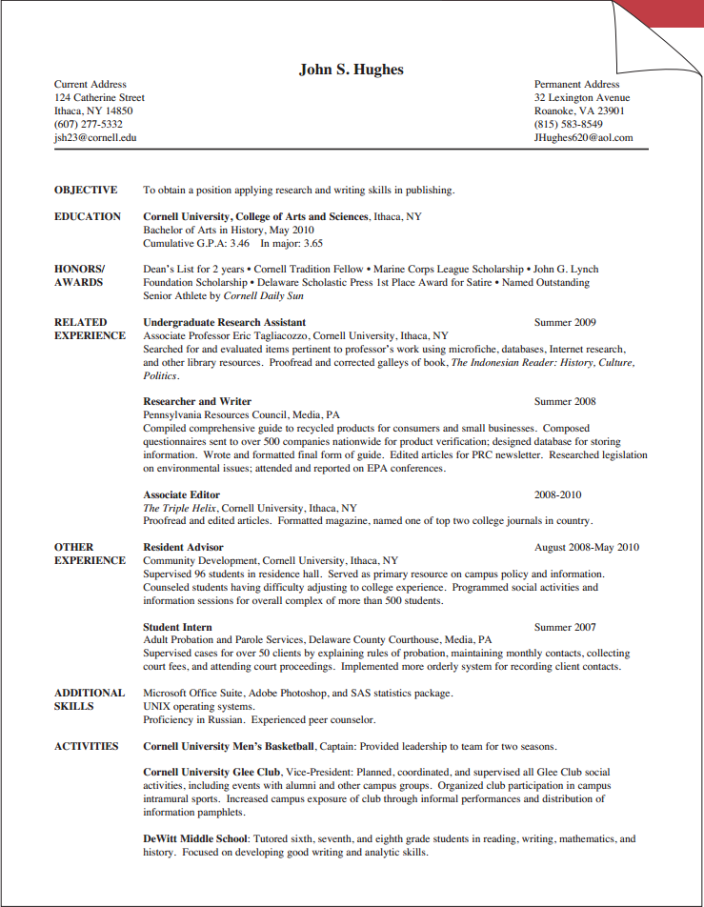
Resume Formats

Slide 28
Resume Formats
FUNCTIONAL FORMAT
  Focuses on skills and abilities, not dates of employment
  Lists skills you’ve demonstrated which are required for a particular job
Allows you to emphasize skills gained through volunteer work and extra curricular activities

Slide 29
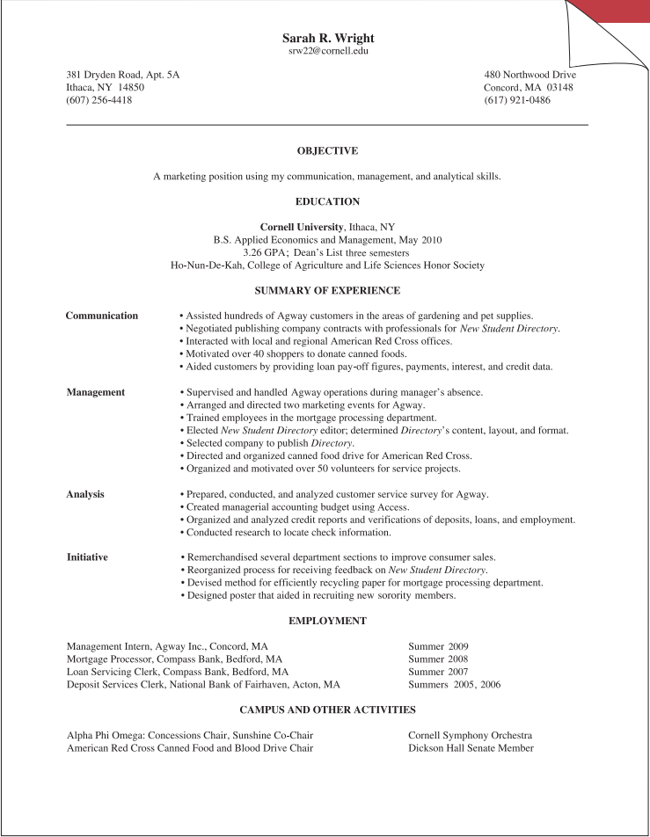
Resume Formats

Slide 30
Resume Formats
COMBINATION FORMAT
  Uses elements of Chronological and Functional
  Emphasizes skills and abilities
  Provides job/experience descriptions
Effective when job objective has multiple components (e.g. research and management, marketing and administrative)

Slide 31
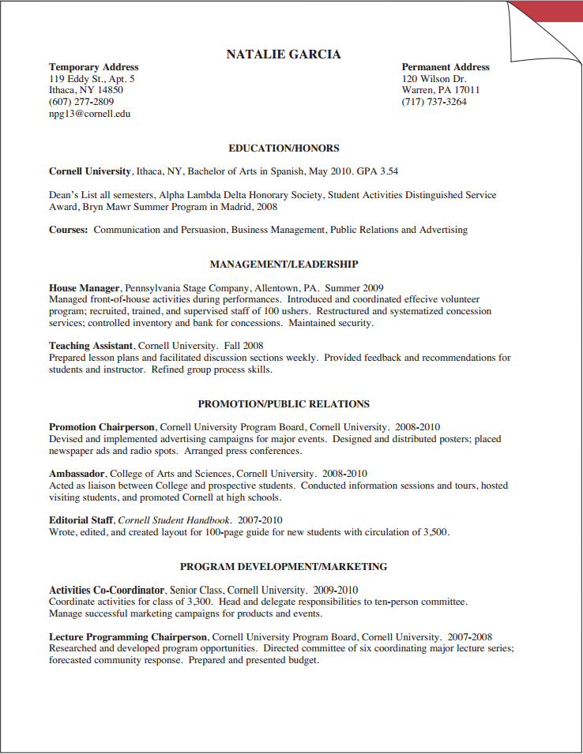
Resume Formats

Slide 32
Resume Formats
TECHNICAL FORMAT
  Used as a term to describe a resume prepared for technical positions (e.g. computer science or engineering)
  Can use any format; emphasizes technical skills such as specific computer languages, laboratory skills, etc.

Slide 33
Resume Checklist

Slide 34
Resume Review Check List
Does your resume look appealing?
Is it clearly labeled, using appropriate headings?
Does it highlight your skills and abilities?
Have you had it critiqued by others?
Have you triple checked for accuracy?

Slide 35
Follow Up
Resume, Curriculum Vitae and Cover Letter examples can be found online at:
  career.cornell.edu/story/resumes/samples.cfm
Feel free to contact any officer of SEBA if you have any questions or concerns about your resume
  Walter Tan – wt97@cornell.edu
  Tim Shao – tss59@cornell.edu

Slide 36
Subcommittees
Each Subcommittee will have a leader
  Leaders must submit a resume for review
Each Subcommittee must present a 15-20 minute powerpoint on their focus during the semester

Slide 37
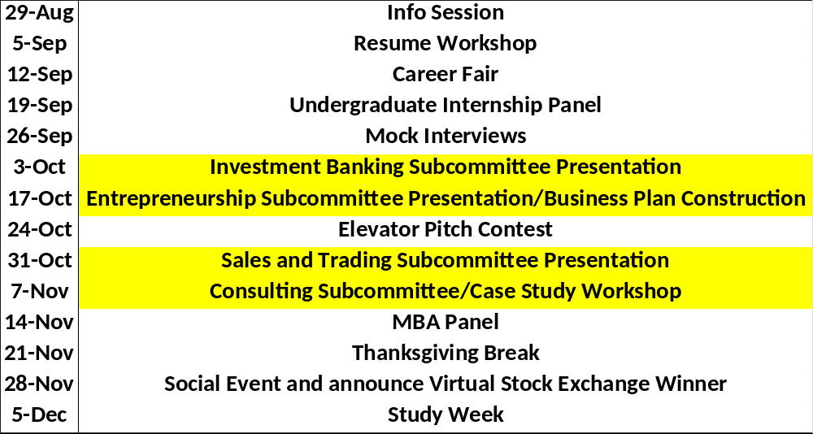
New Schedule

Slide 38
Subcommittees
Investment Banking
  Mergers, IPOs, Financial Instruments
Entrepreneurship
  Startups, Business Plans, Venture Capital
Sales and Trading
  Stock Pitches, Quantitative analysis
Consulting
  Case Studies, Consulting Frameworks

